Slide 1

Presented By-
Sanjay Jayraj
1MJ14CS124
Seminar Guide-
Ms. B. Kalaimathi
Assistant Proffesor, Dept of CSE,
MVJCE, Bangalore
A Seminar Presentation on
“Facial Recognition Using Convolutional Neural Network Based on TensorFLow”

Slide 2
Content Outline:
Introduction
Literature Survey
Approach
Face Detection
Convolutional Neural Networks
Outcome
Conclusions and Future Works

Slide 3
Introduction:
As IT keeps growing there is a lot of information on the internet thus security of the information has also become serious. There are many applications including online banking, e-commerce, as well as national security and so on, which are in urgent need of effective identification technology to protect the user's security.
The best method for security along with passwords is biometrics which includes fingerprints, iris, retinal scans DNA ,gait analysis etc one such biometric is facial recognition.
Face recognition comes under no contact method due to its physiological nature of biometric security.
It's a widely accepted method because of its wide range of applications and use cases.

Slide 4
Literature Survey:
Face Recognition becomes one of the most important biometrics authentication techniques from the past few years. Face recognition is an interesting and successful application of Pattern recognition and Image analysis. Face recognition system has two main tasks: verification and identification.
There are basically three approaches for face recognition
A. Feature based approach: In feature based approach the local features like nose, eyes are segmented and it can be used as input data in face detection to easier the task of face recognition.
B. Holistic approach: In holistic approach the whole face taken as the input in the face detection system to perform face recognition.
C. Hybrid approach: Hybrid approach is combination of feature based and holistic approach. In this approach both local and whole face is used as the input to face detection system.

Slide 5
Techniques for Face Recognition:
A. Eigenface
The Eigenface method is one of the generally used algorithm for face recognition. Karhunen-Loeve is based on the eigenfaces technique in which the Principal Component Analysis (PCA) is used
B. Neural Networks
The neural networks are used in many applications like pattern recognition problems, character recognition, object recognition, and autonomous robot driving. The main objective of the neural network in the face recognition is the feasibility of training a system to capture the complex class of face patterns.

Slide 6
Approach:
Here Adaboost algorithm is used as it's the fastest detection method in speed. The clearest description of state information are the algorithms based on Hidden Markov Model (HMM) and texture feature. In our work, we apply Adaboost algorithm to train the cascade classifier to detect and track human faces accurately and in real time, which is benefit for back-end face recognition.
The Eigenface method based on Principal Component Analysis (PCA), using PCA transform to reduce the original image processing, and then to classify and identify values which will increase the efficiency of the algorithm and the recognition performance can be further improved by appropriately increasing in the number of network neurons and the number of training samples.

Slide 7
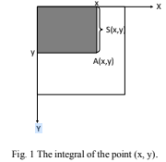
Face Detection:
Before recognition of faces we need to detect and identify the faces the methods that we use are mentioned in the previous slides now lets see how it is implemented.
The Haar eigenvalue, that is, the rectangle feature is the difference between the sum of the black pixels in the feature rectangle and the sum of the white pixels. Using the traditional calculation method, it is necessary to scan all the pixels in the rectangle. The integral graph, an improved algorithm, is adopted.
As shown in Fig. 1, A (x, y) represents the integral of the point (x, y), and S (x, y) represents the sum of all the original images in the y direction of the point (x, y).

Slide 8
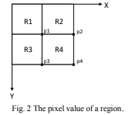
Where, image (x1, y1) represents the original image, and the color image is the color value of the point, and for the gray scale image, the range of its gray value is 0 ~ 255.

Slide 9
As shown in the Fig. 2, there are four areas, namely R1, R2,R3, R4, coordinates points p1, p2, p3, p4. The pixel value of the region R4 is A (p4) + A (p1) -A (p2) -A (p3). The pixel value of a region can be calculated using the integral plot of the endpoints of the region. Let (x, y) be the origin of the rectangle, w be the width, h be the height. Let SumOfRect (x, y, w, h) be the region and the value.
SumofRect (x, y, w, h )=Sum( x-1, y-1)
+Sum (x +w-1, y+ h-1) -Sum (x-1 ,y+ h-1)
-Sum( x+ w-1, y-1)
Therefore, the eigenvalues of the rectangle feature are only related to the integral graph of the endpoint of the feature rectangle, instead of the coordinates of the image. The eigenvalues can be obtained by calculating the integral graph of the endpoints of the feature rectangles and then simply adding and subtracting them. Therefore, the calculation speed of the feature is greatly improved, and the detection speed of the target is also improved.

Slide 10
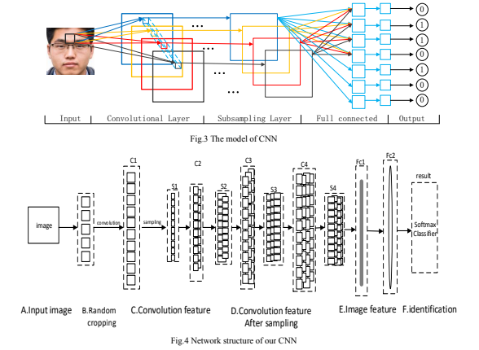

Slide 11
Convolutional Neural Networks:
What is CNN?
In 1960s, Hubel and Wiesel found that the unique network structure which can effectively reduce the complexity of the feedback neural network in the study of neurons with local sensitivity and direction selection in the cortex of cats. Andthen a convolution neural network (Convolutional Neural Networks -CNN) is proposed.
Convolution neural network is a non-fully connected multi-layer neural network, which contains convolutional layers (Convolutional Layer, C) and sampling layer (Subsampling Layer S), and the hidden layer of the whole network is composed of convoluted layer and subsampling Layer.

Slide 12
In this paper along with CNN ,Tensorflow is used which is a deep learning tool from Google.
TensorFlow is an open source software library for numerical computation using data flow graphs . It is a system that transfers complex data structures to artificial neural networks for analysis and processing. It can be used in many areas of deep learning such as speech recognition and image recognition.
What is Deep Learning?
Deep learning is a subset of machine learning in Artificial Intelligence (AI) that has networks which are capable of learning unsupervised form data that is unstructured or unlabeled. Also known as Deep Neural Learning or Deep Neural Network.

Slide 13
Outcome:
The result of the test is that the method with our CNN has an accuracy of 87.0%. False positive is 22, that is, non-target is recognized as the target. And 13 missed, that is, the target identified as non-target. The traditional method of false positive is 34, missing 27. The CNN model is significantly better.

Slide 14
Conclusion and Future Works:
The performance of face recognition is often very poor in a constrained environment, such as illumination changes, shooting angle, distance, pose, and facial expressions and so on which will affect the accuracy of recognition. Compared with traditional hand-crafted features, CNN learning features have better robustness to face recognition in complex environments.
In the future work, in order to improve the accuracy of face detection, we will use CNN cascade to improve accuracy and response time. Also use it for applications such as biometric unlocking smartphones.

Slide 15
Thank you

